Slide 1

CLIMATE-RELATED TWITTER FEEDBACK ANALYSIS Using Bert
By: Yihang Hu, Qingcheng Wei, Zinan Zhang, Chengze Xie

Slide 2
GOAL OF THIS PROJECT
Utilizing a pre-trained model, we gather Tweets related to climate change and search for a relationship between whether this Tweet will gain public support and the content of the post.

Slide 3

Why we choose this project?

Slide 4


GOAL OF THIS PROJECT
1. Facilitate user retention and interaction
2. Prone to receive positive Tweets

Slide 5
Benefit of this project
1. Facilitate user retention and interaction
Whenever users post a tweet, system will use our algorithm to identify whether the tweet will be liked or not.
Based on the result, the system will push tweets that will be liked a lot forward than others when users search for climate or environment related topic
And it will facilitate user interaction with the platform and improve the user stickiness

Slide 6
GOAL OF THIS PROJECT
2. Prone to receive positive Tweets
Popular tweets are likely to contain positive and profound environmental-related topics.
With positive tweets pushed to the top, public awareness on climate change can be raised.

Slide 7
DATA GATHERING
1. We use the <Tweepy> package to request for twitter API by providing its specific ID number
2. We clean the table by removing all the Nah values in the table, organizing into Texts and Labels which are our associated X and Y values.
3. We save our data into csv file for future references and feed it into our pre-training model

Slide 8
DATA GATHERING Example
Given: Twitter ID number: 1028957353322762240
2. Use the ID as our parameter and put into API request functions from Tweepy package
get_tweets() & get_liking_users()
3. We get the twitter texts and liking numbers associated with this ID:
Text: “An eye-opening article. This further reinforces the need to switch to a more enviroment friendly lifestyle.\n@EamonRyan thank you for sharing this!”
Label: 0

Slide 9
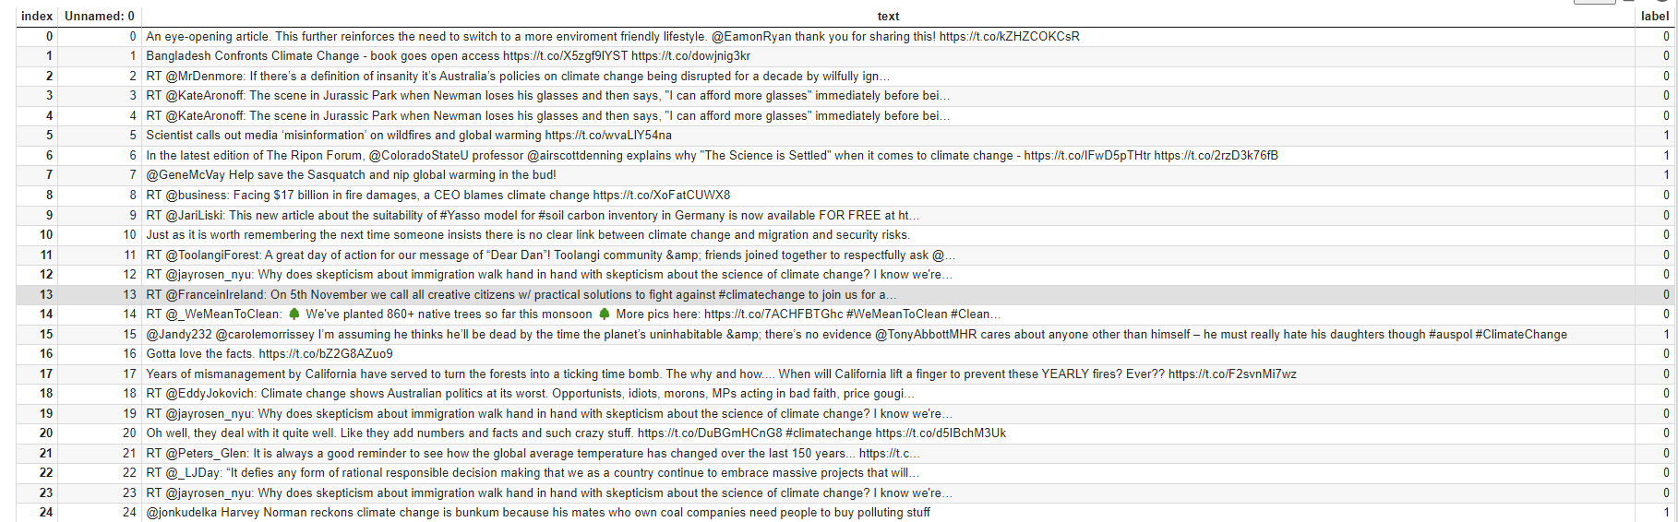
DISPLAY THE DATASET

Slide 10
Pre-training Model
With the help of this model, we transform the text into numbers by the Lookup table
Bert_Tokenizer
With the help of this Bert specific tokenizer, we are able to
Faster rate to remove the text disambiguate.
Tokenize the tweets that including emojis and other Twitter norms
Split the word into multiple tokens. This will help classify words with multiple forms.

Slide 11
Why choose Bert transformer?
Bert Transformer
Non-sequential: Sentences are processed as a whole rather than word by word(Solving long dependency issues)
Self Attention: Auto compute similarity scores between words in a sentence
Positional Embeddings: introduced to replace recurrence(Providing relationship between different words ).
RNN/LSTM
Sequential Processing: sentences must be processed word by word
Markov property: each state is only dependent on the previously seen state

Slide 12
MODEL
We use a pre-trained model that has been trained on 48368 tweets.
The architecture of our model: We have 11 Bert Layers.
We have carefully chosen the hyperparameters of this model given our relatively small sample size compared to the dataset used in pre-trained process.

Slide 13
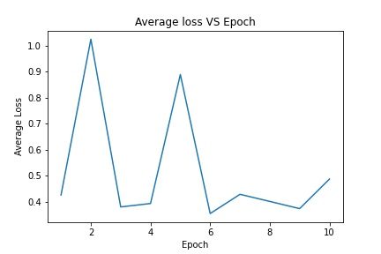
FINAL OUTPUT
The figure on the right represents the average training losses’ variances in each epochs. At last based on our experiment, we got the testing accuracy of 83.82%

Slide 14
Reference
Pre-trained model acquisition:
1: https://github.com/avishreekh/Depression-detection-using-Twitter-posts
Data acquisition:
2: Climate Change Tweets Ids - GWU Libraries Dataverse (harvard.edu)

Slide 15
Q & A

